Slide 1
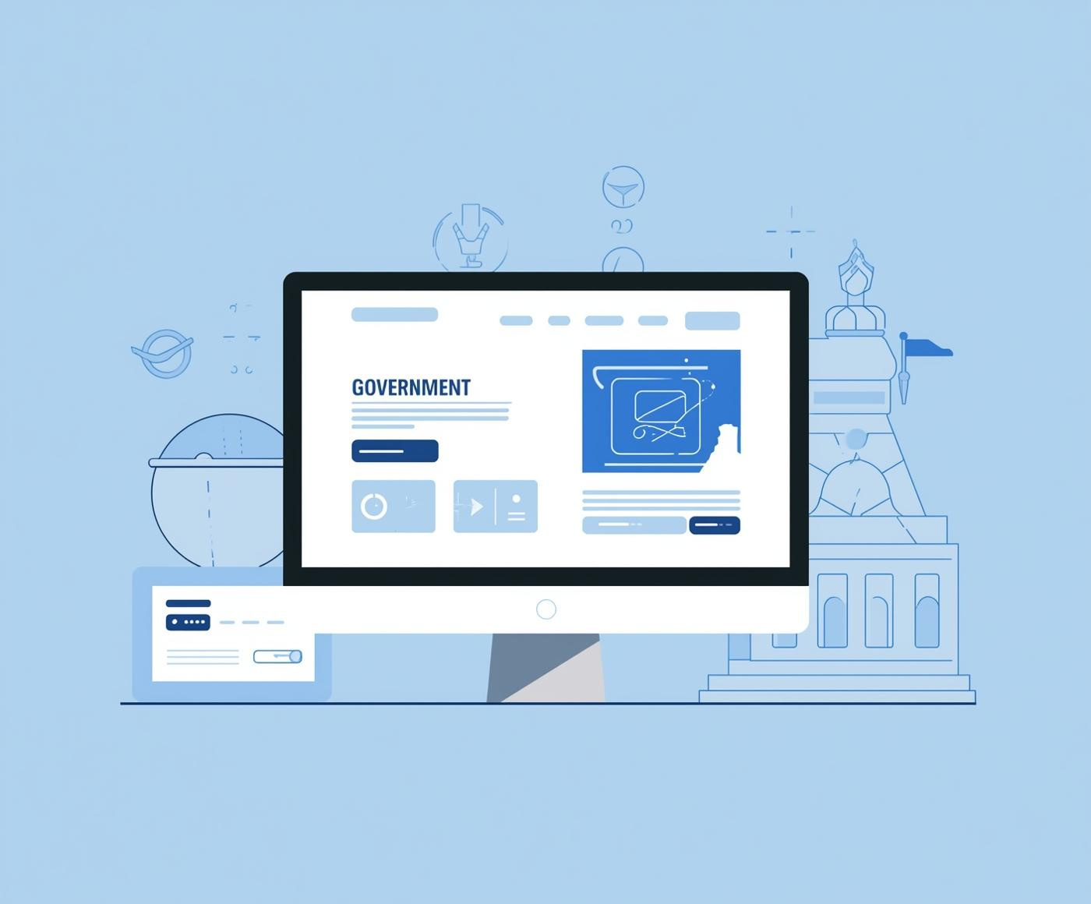
Redesigning the Egyptian Tansik Government Website
ENHANCING USER EXPERIENCE FOR HIGH SCHOOL GRADUATES
Abdelgawad Mohamed Abdelgawad
Ahmed Abdelmagid Attia Zalat
Eman Sherif Abdelwanis Gabr
Hamdy Nashat Eid Saleh Dohim
Mohamed Ali Elshahat Abohelal
Sama Mohamed Roshdy Mohamed

Slide 2

Target User: High School Graduates
Key Pain Points
High Cognitive Load: Information overload.
Poor Navigation: Users feel lost.
Outdated UI: Lack of visual hierarchy.

Slide 3
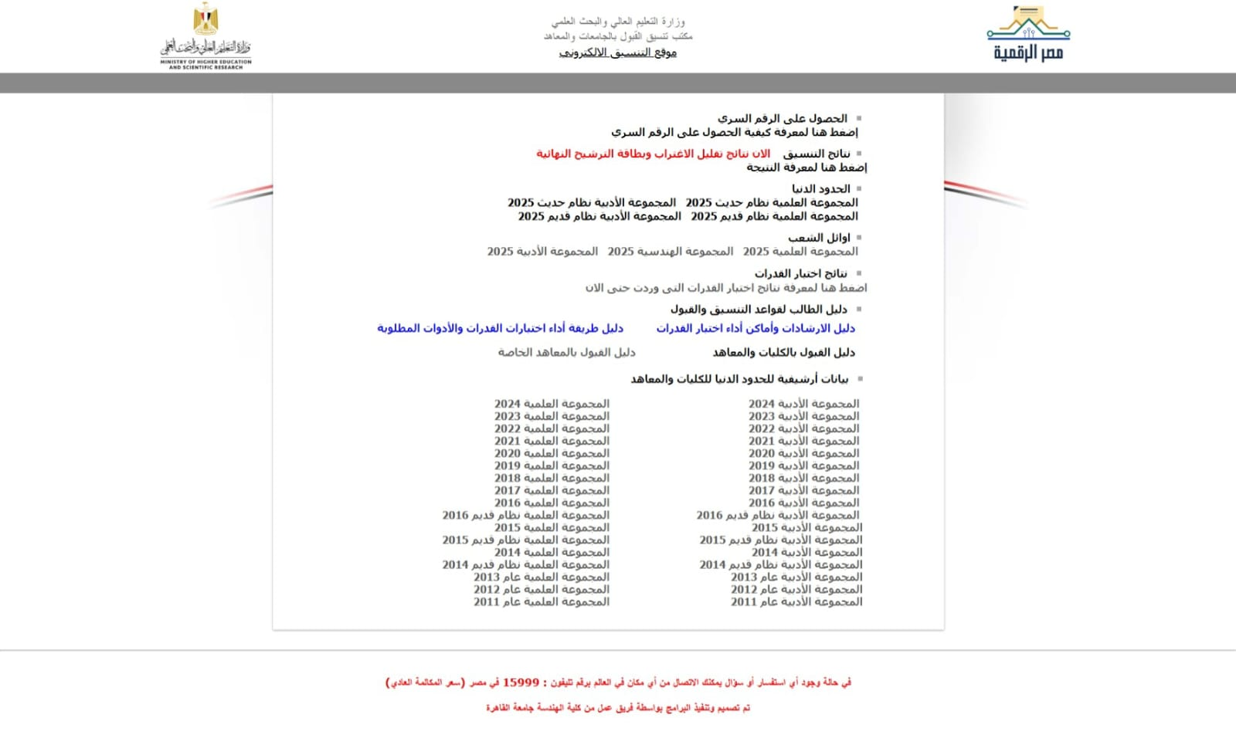
Heuristic Violation
Bad Affordance
Users struggle with unclear interactive elements
Clutter
Overwhelming elements disrupt user experience
Inconsistency
Mixed elements cause confusion across pages
Poor Navigation
Difficulty finding essential features and information

Slide 4

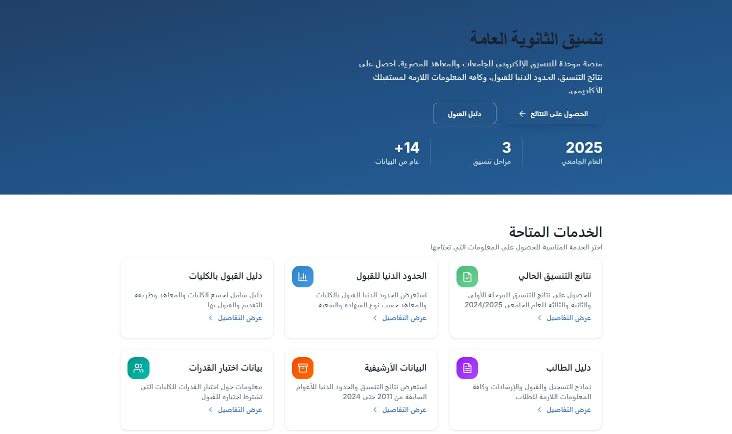
Modern Design & Better Usability.
Concepts: Visibility & Mapping.
Improvements:
Layout: Clear "Cards" layout to organize scattered services.
Visual Hierarchy: Used intuitive icons to ensure instant recognition.

Slide 5
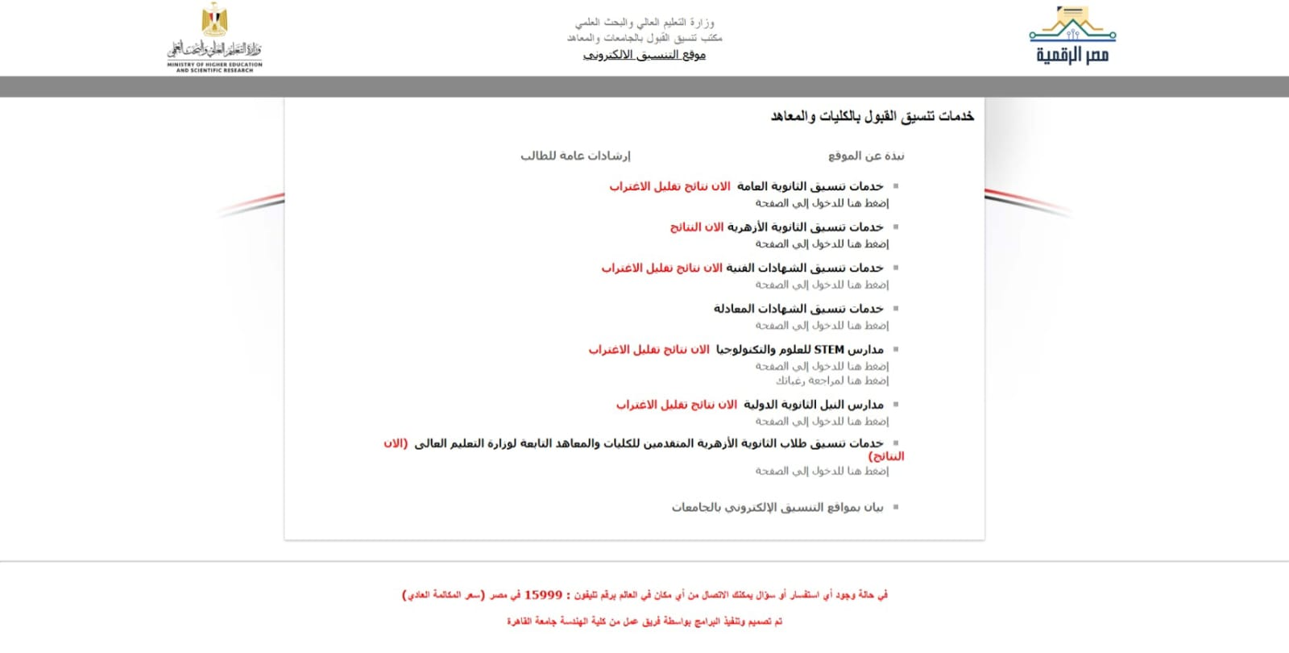
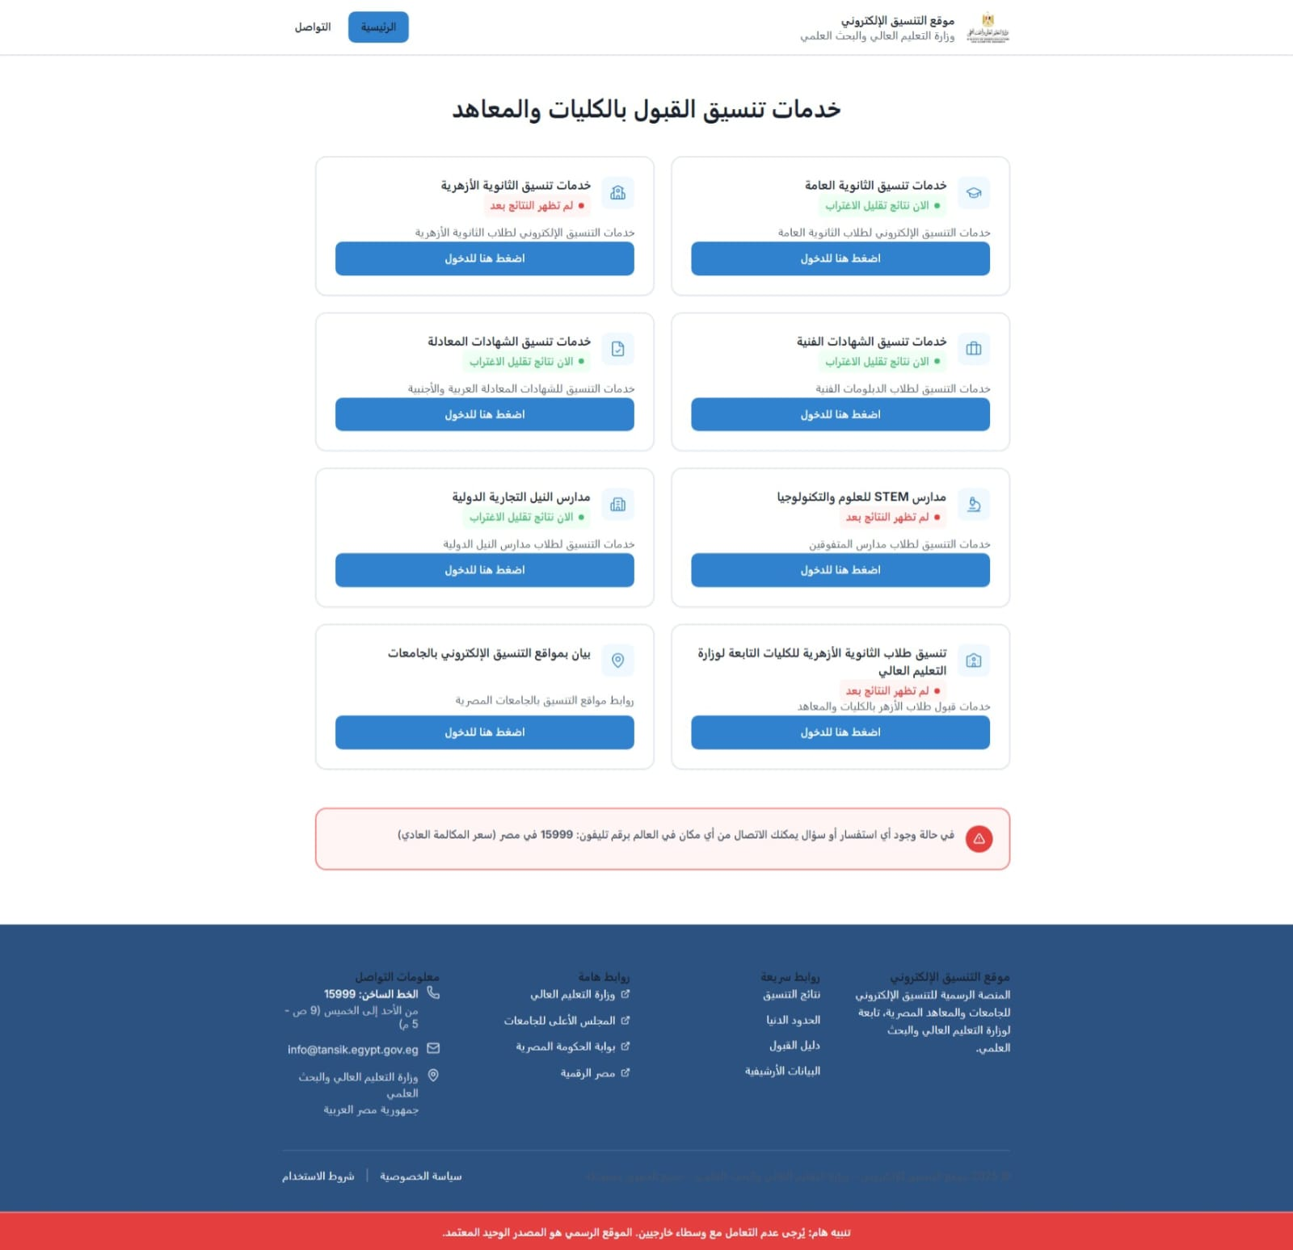
Enhancing Navigation & Affordance
Concept: Affordance & Feedback.
Improvements:
Affordance: Replaced plain text links with clear Call-to-Action (CTA) buttons.
Feedback: Added color-coded labels (Green/Red) to clearly indicate system status.

Slide 6
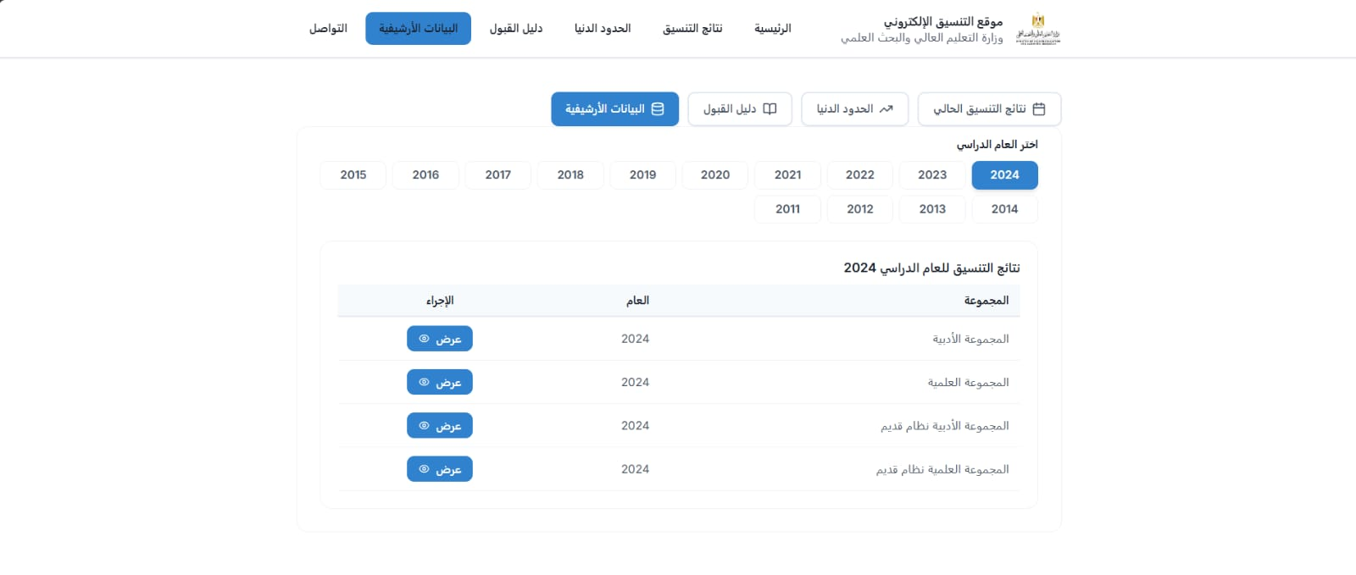
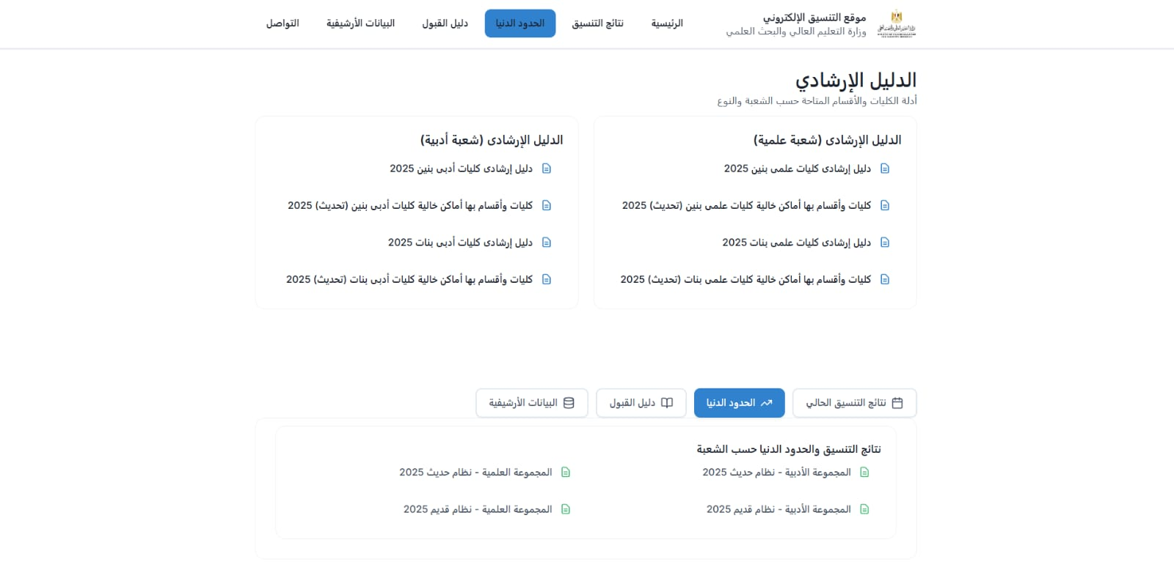
Efficient Data Presentation
Concepts: Efficiency & Readability.
Improvements:
Filtering: Replaced long scroll with year selection.
Structuring: Categorized complex data for easy scanning.

Slide 7
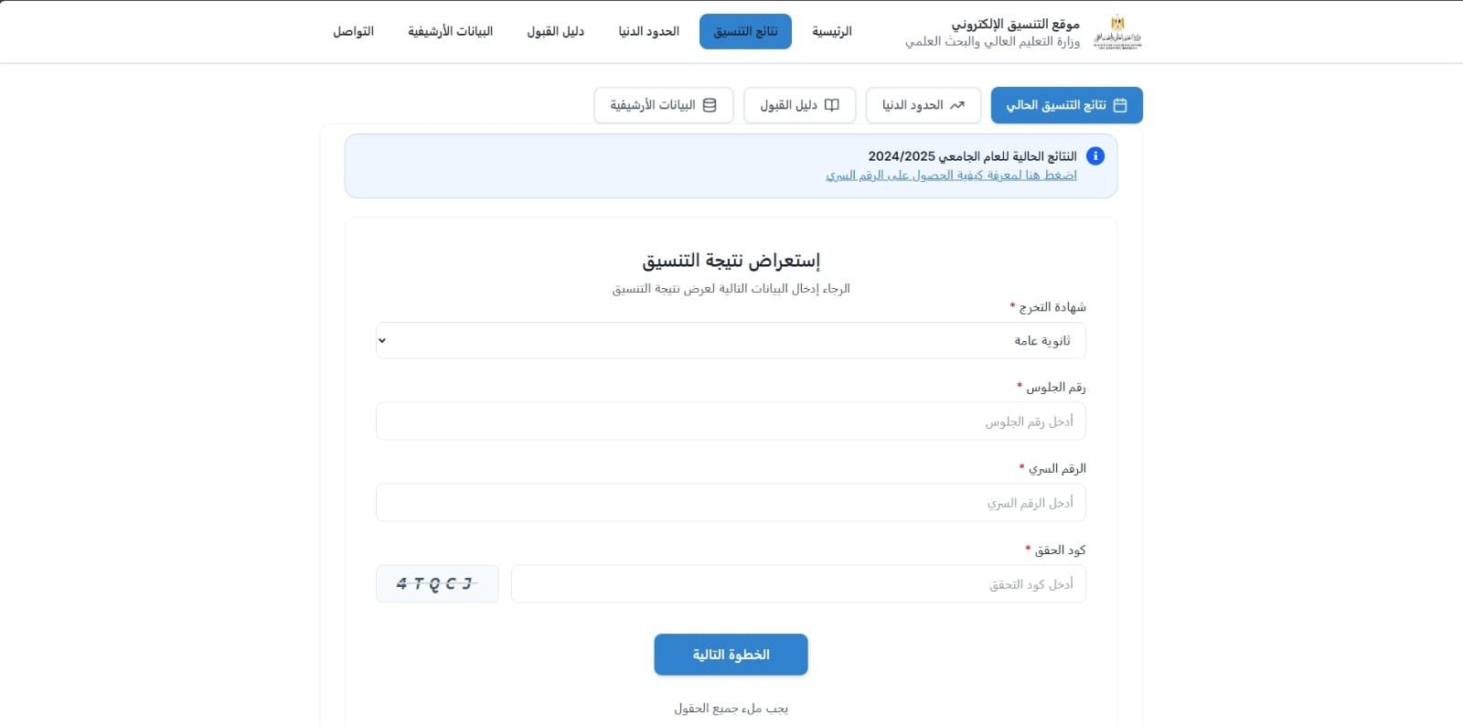
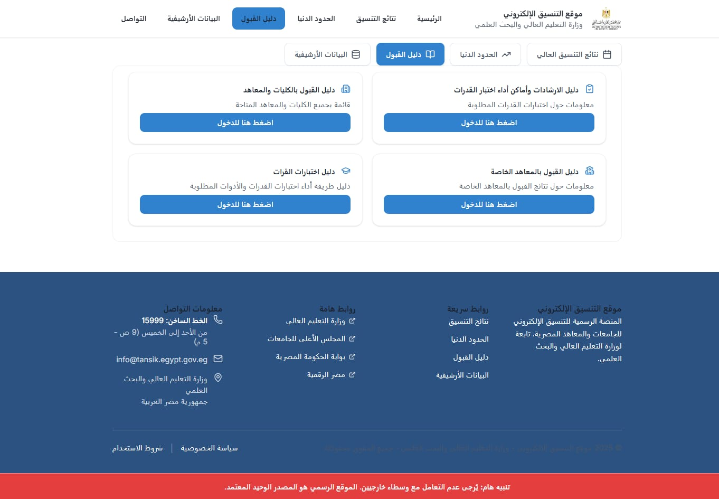
Interaction & Error Prevention
Concepts: Safety, Affordance, & Feedback.
Improvements:
Safety: Clear input fields with placeholders to prevent errors.
Affordance: Large clickable cards for easier navigation.

Slide 8
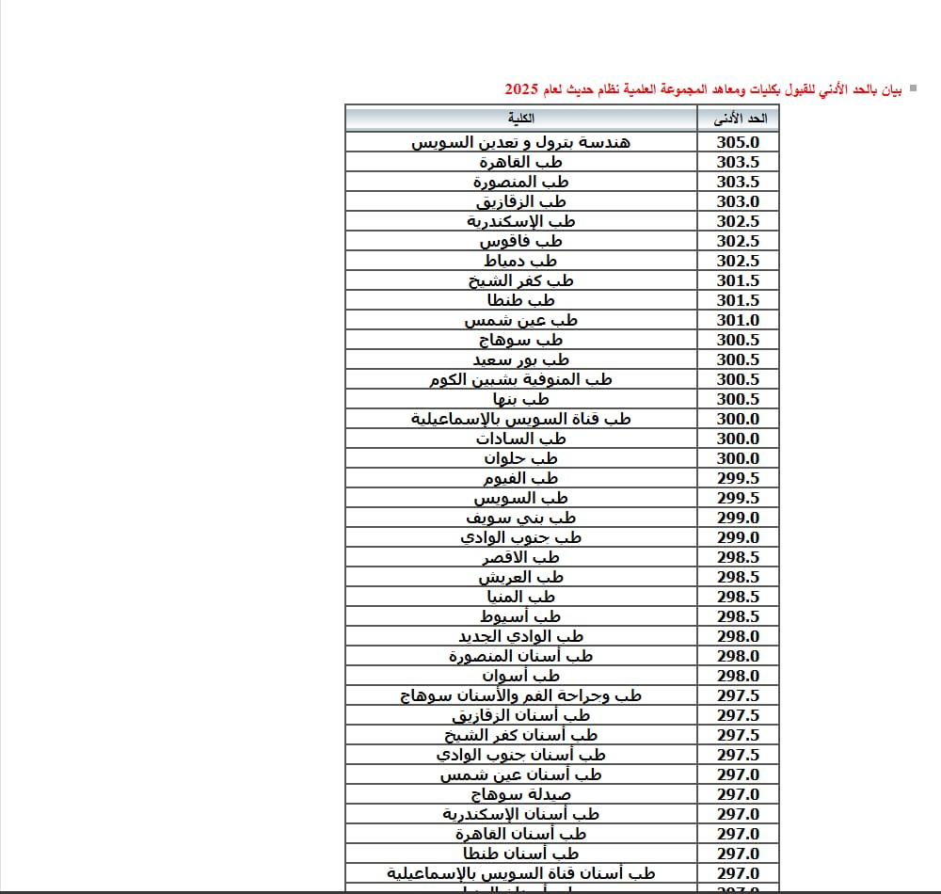
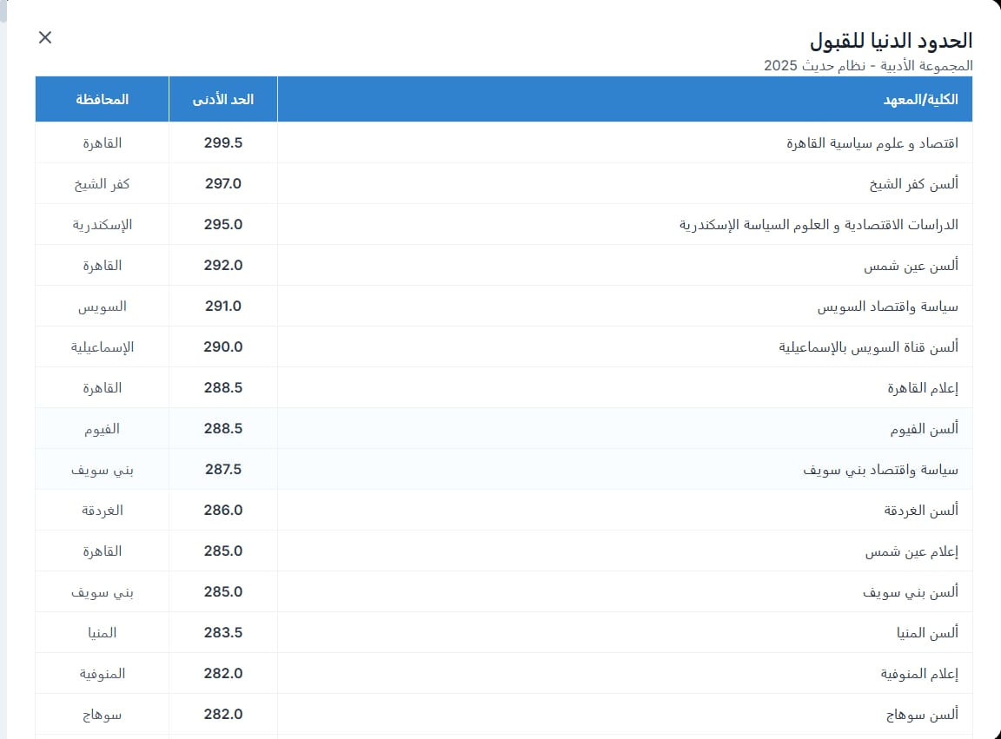
Enhancing Readability (Data Tables)
Concepts: Aesthetic Minimalist Design & Visual Hierarchy.
Improvements:
Minimalism: Removed heavy grid lines to reduce visual clutter.
Scannability: Added whitespace and distinct headers for faster data retrieval.

Slide 9

Usability Goals
Improving Efficiency and Learnability for Enhanced User Experience
Our project focused on maximizing efficiency and enhancing learnability to ensure users can navigate the redesigned site effortlessly. By prioritizing these goals, we aimed to create an intuitive interface that reduces frustration and enhances overall satisfaction. This approach not only streamlines user interactions but also supports effective information retrieval.

